Slide 1
NOJ season 3
Fang Wang

Slide 2
season 3
Constant E
Sum
Prime numbe
Prime number II
Prime number III
Perfect number
Power Of X
Fraction sequence
PI
The cube of a natural number

Slide 3
How to write a program?
Get rooms
Step 1: declare variables
Step 2: input data
Step 3: calculate
Step 4: output
Store data
calculate
print the result

Slide 4
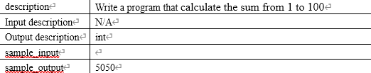
Sum

Slide 5
The for Statement
expr1 is an initialization step that’s performed only once, before the loop begins to execute.
expr2 controls loop termination (the loop continues executing as long as the value of expr2 is nonzero).
expr3 is an operation to be performed at the end of each loop iteration.
for (i = 1; i <= n; i++) statement
initialization
controlling expression
increment
decrement
i is the loop control variable

Slide 6
For是计数型的循环，循环变量就是一个计数器。每循环一次，循环变量加或减一次
for (i = 1; i <= n; i++) statement
expr1 i = 1
循环变量（计算器）赋初值
循环条件成立吗?
计数器没到终值
expr2 i <= n
F(0)
T(None 0)
statement
执行循环体
expr3 i++
循环变量（计算器）
加上增量

Slide 7
Step 1: declare variables
Step 2: input data
Step 3: calculate
Step 4: output
int i,sum=0;
for(i=1;i<=100;i++)
sum+=i;
printf("%d",sum);

Slide 8
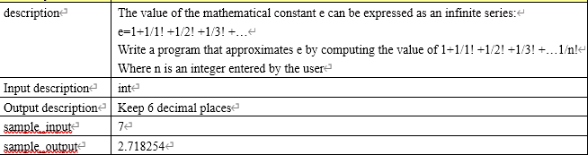
Constant E

Slide 9
Step 1: declare variables
Step 2: input data
Step 3: calculate
Step 4: output
int n,i;
double e=1,t=1;
scanf("%d",&n);
for(i=1;i<=n;i++)
{
t=t/i;
e+=t;
}
printf("%f",e);

Slide 10
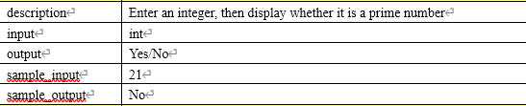
Prime numbe

Slide 11
int i,m;
scanf("%d",&m);
for(i=2;i<m;i++)
if(m%i==0)break;
if(i==m)
printf("Yes\n");
else printf("No\n");

Slide 12
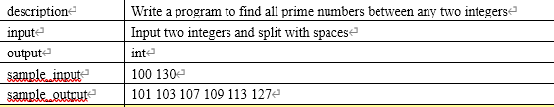
Prime number II

Slide 13
int a,b,i,m;
scanf("%d%d",&a,&b);
if(a>b) i=a,a=b,b=i; //Exchange a and b, make sure a is smaller and B is greater
for(m=a;m<=b;m++) // test all the numbers between a and b
{
for(i=2;i<m;i++)
if(m%i==0)break;
if(i==m) printf("%d ",m);
}

Slide 14
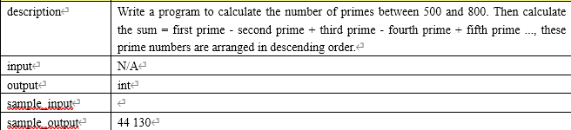
Prime number III

Slide 15
int i,cnt=0,m,sum=0,s=-1;
for(m=799;m>500;m=m-2)
{
for(i=2;i<m;i++)
if(m%i==0)break;
if(i==m)
{
s=-s;
sum=sum+s*m;
cnt++;
}
}
printf("%d %d",cnt,sum);

Slide 16
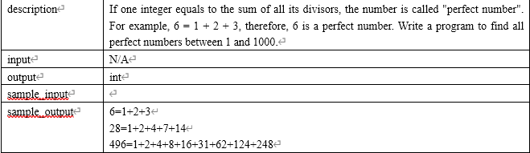
Perfect number

Slide 17
int a,i,sum;
for(a=1;a<=1000;a++){
for(i=1,sum=0;i<a;i++) //figure out the perfect numbers
if(a%i==0) sum+=i;
if(sum==a){ //If the sum of the factors of a is equal to a, then a is a perfect number printf("%d=1",a);
for(i=2;i<a;i++) // Divide again and output all factors
if(a%i==0) printf("+%d",i);
printf("\n");
}
}

Slide 18
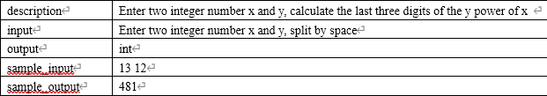
Power Of X

Slide 19
int x,c=1,i,y;
scanf("%d%d",&x,&y);
for(i=1;i<=y;i++)
{
c=c*x;
c=c%1000;
}
printf("%d",c);

Slide 20
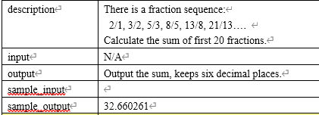
Fraction sequence

Slide 21
double s,n,m,a,b;
n=1; s=0; m=2; a=1;
while (a<=20) {
s=s+m/n;
b=m;
m=n+m;
n=b;
a=a+1;
}
printf("%f",s);

Slide 22
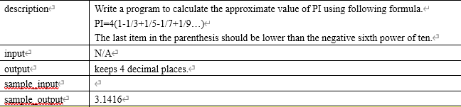
PI

Slide 23
int s=1;
double pi=0,n=1,t=1;
while (fabs(t)>1e-6)
{ pi=pi+t; n=n+2; s=-s; t=s/n;}
pi=pi*4;
printf("%.4f\n",pi);

Slide 24
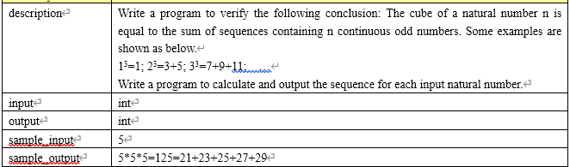
The cube of a natural number

Slide 25
int n,j,k,s,t;
scanf("%d",&n);
k=n*(n-1)+1; //First number: 5*5*5=125=21+23+25+27+29
s=t=k;
for(j=1;j<n;j++){
t=t+2;
s=s+t;
}
if(s==n*n*n)
{
printf("%d*%d*%d=%d=",n,n,n,s); // output : 5*5*5=125=
printf("%d",k); //output : 21
for(j=1;j<n;j++){
k=k+2;
printf("+%d",k); //output : +23
}
}

